Slide 1
CSS
Fundamentet

Slide 2
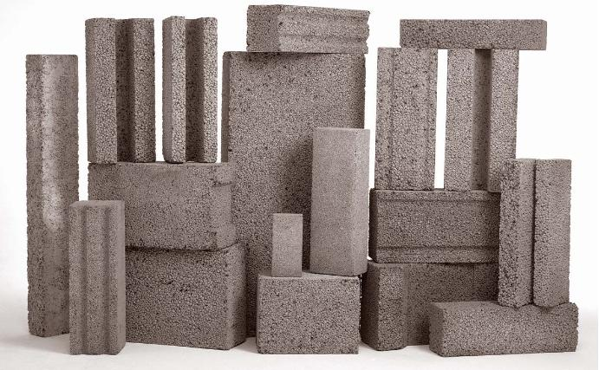
Introduksjon
Oppsett
Struktur
Navngiving
Styling

Slide 3
Hvorfor CSS?
Separere innhold (HTML) fra utseende (STYLE)
Gjenbruk av stiler
Forenkle kode
HTML
CSS

Slide 4


p {
color: pink;
font-size: 40px;
}
Og vinneren er:
style
<p>Rosa tekst</p>
<p style="color: pink; font-size: 40px;">
Rosa tekst
</p>

Slide 5
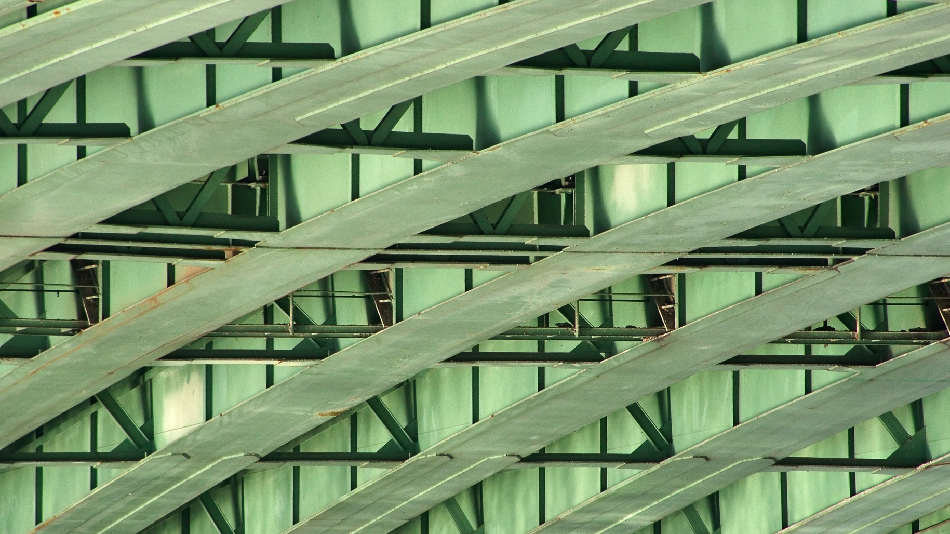
STRUKTUR

Slide 6

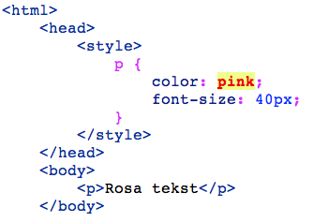
Hvor skal stilene ligge?
Legg CSS i egen fil
Ryddig
Lovlig

Slide 7
Oppsett av CSS-fil
Del opp i seksjoner
enklere å lage innholdsfortegnelse, eller generere style guide
/* 1. RESET
-----------------------------------------------------------------------------------------------
===============================================================================================*/
/* http://meyerweb.com/eric/tools/css/reset/ */
html,body,div,span,applet,object,iframe,h1,h2,h3,h4,h5,h6,p,blockquote,pre,a,abbr,acronym,address,big,cite,code,del,dfn,em,img,ins,kbd

Slide 8
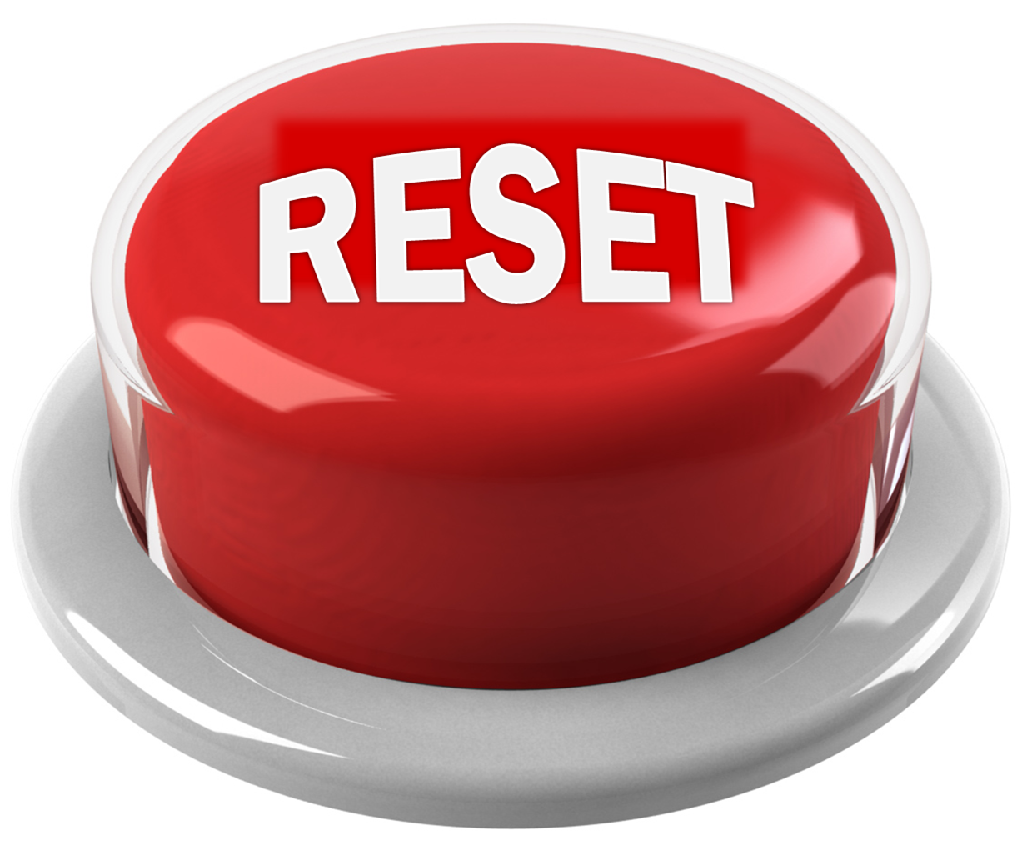
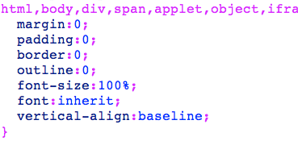
Reset css
finn noe ferdig (f.eks. Eric Meyer)
husk kreditering når du bruker andres kode
“Nullstiller” automatisk styling, som er forskjellig fra nettleser til nettleser

Slide 9

Tommelfinger-regel
Mest generiske stiler først
så mindre
og mindre
generisk
mest spesifisert til slutt

Slide 10
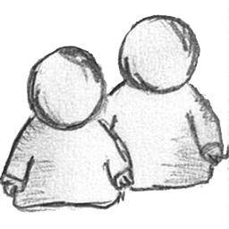
Body default
Har du slettet alle browser-bestemte stiler, må du opprette ditt eget stilige utgangspunkt.
Standard marger, line-heights, default font size, størrelser på h-tagger, font-family…
/* BODY DEFAULTS
--------------------------------------------------------- */
html{
margin-bottom: 1px;
min-height: 100%;
}
body {
background: #F0F0F0;
color: #444;
font-family: Georgia, serif;
font-size: 62.5%;

Slide 11
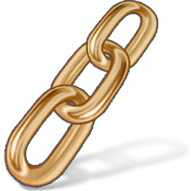
Link styles
a, a:visited{
color: #0090D2;
text-decoration: none;
}
a:hover {color: #0063A6;}
a:active,a:focus{
color: #0063A6;
position: relative;
top: 1px;
}

Slide 12
ETC. ETC.
/* HEADINGS */
/*ELEMENTS*/
Global id’s and classes
…

Slide 13
Tips:
/* TEMPLATE COLOURS */
.blue {color: #0098d8}
.red {color: #de1638}
.orange {color: #dd7737}
.green1 {color: #a59e10}
.green2 {color: #868507}

Slide 14
''; } .navbar .nav > li > .dropdown-menu:after { position: absolute; top: -6px; left: 10px; display: inline-block; border-right: 6px solid transparent; border-bottom: 6px solid #ffffff; border-left: 6px solid transparent; content: ''; } .navbar-fixed-bottom .nav > li > .dropdown-menu:before { top: auto; bottom: -7px; border-top: 7px solid #ccc; border-bottom: 0; border-top-color: rgba(0, 0, 0, 0.2); }
.navbar-fixed-bottom .nav > li > .dropdown-menu:after { top: auto; bottom: -6px; border-top: 6px solid #ffffff; border-bottom: 0; } .navbar .nav li.dropdown > a:hover .caret { border-top-color: #555555; border-bottom-color: #555555; } .navbar .nav li.dropdown.open > .dropdown-toggle, .navbar .nav li.dropdown.active > .dropdown-toggle, .navbar .nav li.dropdown.open.active > .dropdown-toggle { color: #555555; background-color: #e5e5e5; } .navbar .nav li.dropdown > .dropdown-toggle .caret { border-top-color: #777777; border-bottom-color: #777777; } .navbar .nav li.dropdown.open > .dropdown-toggle .caret, .navbar .nav li.dropdown.active > .dropdown-toggle .caret, .navbar .nav li.dropdown.open.active > .dropdown-toggle .caret { border-top-color: #555555; border-bottom-color: #555555; } .navbar .pull-right > li > .dropdown-menu, .navbar .nav > li > .dropdown-menu.pull-right { right: 0; left: auto; } .navbar .pull-right > li > .dropdown-menu:before, .navbar .nav > li > .dropdown-menu.pull-right:before { right: 12px; left: auto; } .navbar .pull-right > li > .dropdown-menu:after, .navbar .nav > li > .dropdown-menu.pull-right:after { right: 13px; left: auto; }
.navbar .pull-right > li > .dropdown-menu .dropdown-menu, .navbar .nav > li > .dropdown-menu.pull-right .dropdown-menu { right: 100%; left: auto; margin-right: -1px; margin-left: 0; -webkit-border-radius: 6px 0 6px 6px; -moz-border-radius: 6px 0 6px 6px; border-radius: 6px 0 6px 6px; } .navbar-inverse .navbar-inner { background-color: #1b1b1b; background-image: -moz-linear-gradient(top, #222222, #111111); background-image: -webkit-gradient(linear, 0 0, 0 100%, from(#222222), to(#111111)); background-image: -webkit-linear-gradient(top, #222222, #111111); background-image: -o-linear-gradient(top, #222222, #111111); background-image: linear-gradient(to bottom, #222222, #111111); background-repeat: repeat-x; border-color: #252525; filter: progid:DXImageTransform.Microsoft.gradient(startColorstr='#ff222222', endColorstr='#ff111111', GradientType=0); } .navbar-inverse .brand, .navbar-inverse .nav > li > a { color: #999999; text-shadow: 0 -1px 0 rgba(0, 0, 0, 0.25); } .navbar-inverse .brand:hover, .navbar-inverse .nav > li > a:hover { color: #ffffff; } .navbar-inverse .brand { color: #999999; } .navbar-inverse .navbar-text { color: #999999; } .navbar-inverse .nav > li > a:focus, .navbar-inverse .nav > li > a:hover { color: #ffffff; background-color: transparent; } .navbar-inverse .nav .active > a, .navbar-inverse .nav .active > a:hover,
.navbar-inverse .nav .active > a:focus { color: #ffffff; background-color: #111111; } .navbar-inverse .navbar-link { color: #999999; } .navbar-inverse .navbar-link:hover { color: #ffffff; } .navbar-inverse .divider-vertical { border-right-color: #222222; border-left-color: #111111; } .navbar-inverse .nav li.dropdown.open > .dropdown-toggle, .navbar-inverse .nav li.dropdown.active > .dropdown-toggle, .navbar-inverse .nav li.dropdown.open.active > .dropdown-toggle { color: #ffffff; background-color: #111111; } .navbar-inverse .nav li.dropdown > a:hover .caret { border-top-color: #ffffff; border-bottom-color: #ffffff; } .navbar-inverse .nav li.dropdown > .dropdown-toggle .caret { border-top-color: #999999; border-bottom-color: #999999; } .navbar-inverse .nav li.dropdown.open > .dropdown-toggle .caret, .navbar-inverse .nav li.dropdown.active > .dropdown-toggle .caret, .navbar-inverse .nav li.dropdown.open.active > .dropdown-toggle .caret { border-top-color: #ffffff; border-bottom-color: #ffffff; } .navbar-inverse .navbar-search .search-query { color: #ffffff; background-color: #515151; border-color: #111111; -webkit-box-shadow: inset 0 1px 2px rgba(0, 0, 0, 0.1), 0 1px 0 rgba(255, 255, 255, 0.15); -moz-box-shadow: inset 0 1px 2px rgba(0, 0, 0, 0.1), 0 1px 0 rgba(255, 255, 255, 0.15); box-shadow: inset 0 1px 2px rgba(0, 0, 0, 0.1), 0 1px 0 rgba(255, 255, 255, 0.15); -webkit-transition: none;
-moz-transition: none; -o-transition: none; transition: none; } .navbar-inverse .navbar-search .search-query:-moz-placeholder { color: #cccccc; } .navbar-inverse .navbar-search .search-query:-ms-input-placeholder { color: #cccccc; } .navbar-inverse .navbar-search .search-query::-webkit-input-placeholder { color: #cccccc; } .navbar-inverse .navbar-search .search-query:focus, .navbar-inverse .navbar-search .search-query.focused { padding: 5px 15px; color: #333333; text-shadow: 0 1px 0 #ffffff; background-color: #ffffff; border: 0; outline: 0; -webkit-box-shadow: 0 0 3px rgba(0, 0, 0, 0.15); -moz-box-shadow: 0 0 3px rgba(0, 0, 0, 0.15); box-shadow: 0 0 3px rgba(0, 0, 0, 0.15); } .navbar-inverse .btn-navbar { color: #ffffff; text-shadow: 0 -1px 0 rgba(0, 0, 0, 0.25); background-color: #0e0e0e; *background-color: #040404; background-image: -moz-linear-gradient(top, #151515, #040404); background-image: -webkit-gradient(linear, 0 0, 0 100%, from(#151515), to(#040404));
SELECTORS

Slide 15
HTML-elementer
HTML-element | CSS-selector
<body> | body{…}
<div> | div{…}
<p> | p{…}
<footer> | footer{…}
Mange flere muligheter enn dette; alle HTML-elementer kan nemlig brukes som selector! Weehuu!
Notes:
Alle HTML-elementer kan brukes som selector
http://www.w3schools.com/cssref/css_selectors.asp

Slide 16
Eksempel på bruk av # og .
HTML-element | CSS-selector
<section id=“bilder”> | #bilder{…}
<div class=“markert”> | .markert{…}
<p class=“uthevet”> | p.uthevet{class som bare virker på en p}
For full oversikt:
http://www.w3schools.com/cssref/css_selectors.asp

Slide 17
CSS3-selectors
/*Velger alle img-elementer på siden hvis src-atributt starter med "images"*/
img[src^="images"]{
border: 5px solid orange;
}
/*Velger alle img-elementer på siden hvis src-atributt inneholder en substring av "tiguan"*/
img[src*="tiguan"]{
border: 5px solid blue;
}
/*Velger alle img-elementer på siden hvis src-atributt slutter på .jpg*/
img[src$=".jpg"]{
width: 10em;
}

Slide 18
Grouping
/* Grouping - flere selektorer, samme stil.
* Litt mindre kode.*/
h1, h2, h3{
color: #446181;
line-height: 2.500em;
margin: 0.625em 0.125em;
}
Velger alle h1, h2 og h3

Slide 19
Nesting
/* Nesting - spesifisering av stil - selector inni selector */
.container p{
color:#000000;
}
Velger alle <p> som ligger i
class=“container”
.markert li ul li p a {/* Uffda */}

Slide 20
Operatorer
selector-eksempel | forklaring
a:hover a:visited | velger hhv. link ved mouse over, og link som har vært besøkt.
div p | velger alle p som er inni en div
div>p | velger alle p som er barn av en div
div+p | velger alle p som er rett etter en div
http://www.w3schools.com/cssref/css_selectors.asp

Slide 21
Navngiving?
p.overskriftPaaSideTre
.tekst1
.tekst2
. fiskebollegryteTullenavn
Bruk mest mulig gjenbrukbare navn
Ideelt sett skal websiden kunne styles om uten å røre HTML-koden
gi navn som beskriver hva noe ER, ikke hvor det er plassert.
Vis eksempel med .class .blue osv

Slide 22
''; } .navbar .nav > li > .dropdown-menu:after { position: absolute; top: -6px; left: 10px; display: inline-block; border-right: 6px solid transparent; border-bottom: 6px solid #ffffff; border-left: 6px solid transparent; content: ''; } .navbar-fixed-bottom .nav > li > .dropdown-menu:before { top: auto; bottom: -7px; border-top: 7px solid #ccc; border-bottom: 0; border-top-color: rgba(0, 0, 0, 0.2); }
.navbar-fixed-bottom .nav > li > .dropdown-menu:after { top: auto; bottom: -6px; border-top: 6px solid #ffffff; border-bottom: 0; } .navbar .nav li.dropdown > a:hover .caret { border-top-color: #555555; border-bottom-color: #555555; } .navbar .nav li.dropdown.open > .dropdown-toggle, .navbar .nav li.dropdown.active > .dropdown-toggle, .navbar .nav li.dropdown.open.active > .dropdown-toggle { color: #555555; background-color: #e5e5e5; } .navbar .nav li.dropdown > .dropdown-toggle .caret { border-top-color: #777777; border-bottom-color: #777777; } .navbar .nav li.dropdown.open > .dropdown-toggle .caret, .navbar .nav li.dropdown.active > .dropdown-toggle .caret, .navbar .nav li.dropdown.open.active > .dropdown-toggle .caret { border-top-color: #555555; border-bottom-color: #555555; } .navbar .pull-right > li > .dropdown-menu, .navbar .nav > li > .dropdown-menu.pull-right { right: 0; left: auto; } .navbar .pull-right > li > .dropdown-menu:before, .navbar .nav > li > .dropdown-menu.pull-right:before { right: 12px; left: auto; } .navbar .pull-right > li > .dropdown-menu:after, .navbar .nav > li > .dropdown-menu.pull-right:after { right: 13px; left: auto; }
.navbar .pull-right > li > .dropdown-menu .dropdown-menu, .navbar .nav > li > .dropdown-menu.pull-right .dropdown-menu { right: 100%; left: auto; margin-right: -1px; margin-left: 0; -webkit-border-radius: 6px 0 6px 6px; -moz-border-radius: 6px 0 6px 6px; border-radius: 6px 0 6px 6px; } .navbar-inverse .navbar-inner { background-color: #1b1b1b; background-image: -moz-linear-gradient(top, #222222, #111111); background-image: -webkit-gradient(linear, 0 0, 0 100%, from(#222222), to(#111111)); background-image: -webkit-linear-gradient(top, #222222, #111111); background-image: -o-linear-gradient(top, #222222, #111111); background-image: linear-gradient(to bottom, #222222, #111111); background-repeat: repeat-x; border-color: #252525; filter: progid:DXImageTransform.Microsoft.gradient(startColorstr='#ff222222', endColorstr='#ff111111', GradientType=0); } .navbar-inverse .brand, .navbar-inverse .nav > li > a { color: #999999; text-shadow: 0 -1px 0 rgba(0, 0, 0, 0.25); } .navbar-inverse .brand:hover, .navbar-inverse .nav > li > a:hover { color: #ffffff; } .navbar-inverse .brand { color: #999999; } .navbar-inverse .navbar-text { color: #999999; } .navbar-inverse .nav > li > a:focus, .navbar-inverse .nav > li > a:hover { color: #ffffff; background-color: transparent; } .navbar-inverse .nav .active > a, .navbar-inverse .nav .active > a:hover,
.navbar-inverse .nav .active > a:focus { color: #ffffff; background-color: #111111; } .navbar-inverse .navbar-link { color: #999999; } .navbar-inverse .navbar-link:hover { color: #ffffff; } .navbar-inverse .divider-vertical { border-right-color: #222222; border-left-color: #111111; } .navbar-inverse .nav li.dropdown.open > .dropdown-toggle, .navbar-inverse .nav li.dropdown.active > .dropdown-toggle, .navbar-inverse .nav li.dropdown.open.active > .dropdown-toggle { color: #ffffff; background-color: #111111; } .navbar-inverse .nav li.dropdown > a:hover .caret { border-top-color: #ffffff; border-bottom-color: #ffffff; } .navbar-inverse .nav li.dropdown > .dropdown-toggle .caret { border-top-color: #999999; border-bottom-color: #999999; } .navbar-inverse .nav li.dropdown.open > .dropdown-toggle .caret, .navbar-inverse .nav li.dropdown.active > .dropdown-toggle .caret, .navbar-inverse .nav li.dropdown.open.active > .dropdown-toggle .caret { border-top-color: #ffffff; border-bottom-color: #ffffff; } .navbar-inverse .navbar-search .search-query { color: #ffffff; background-color: #515151; border-color: #111111; -webkit-box-shadow: inset 0 1px 2px rgba(0, 0, 0, 0.1), 0 1px 0 rgba(255, 255, 255, 0.15); -moz-box-shadow: inset 0 1px 2px rgba(0, 0, 0, 0.1), 0 1px 0 rgba(255, 255, 255, 0.15); box-shadow: inset 0 1px 2px rgba(0, 0, 0, 0.1), 0 1px 0 rgba(255, 255, 255, 0.15); -webkit-transition: none;
-moz-transition: none; -o-transition: none; transition: none; } .navbar-inverse .navbar-search .search-query:-moz-placeholder { color: #cccccc; } .navbar-inverse .navbar-search .search-query:-ms-input-placeholder { color: #cccccc; } .navbar-inverse .navbar-search .search-query::-webkit-input-placeholder { color: #cccccc; } .navbar-inverse .navbar-search .search-query:focus, .navbar-inverse .navbar-search .search-query.focused { padding: 5px 15px; color: #333333; text-shadow: 0 1px 0 #ffffff; background-color: #ffffff; border: 0; outline: 0; -webkit-box-shadow: 0 0 3px rgba(0, 0, 0, 0.15); -moz-box-shadow: 0 0 3px rgba(0, 0, 0, 0.15); box-shadow: 0 0 3px rgba(0, 0, 0, 0.15); } .navbar-inverse .btn-navbar { color: #ffffff; text-shadow: 0 -1px 0 rgba(0, 0, 0, 0.25); background-color: #0e0e0e; *background-color: #040404; background-image: -moz-linear-gradient(top, #151515, #040404); background-image: -webkit-gradient(linear, 0 0, 0 100%, from(#151515), to(#040404));
EKSEMPLER

Slide 23

Kodeeksempel – boks uten hjørner
.container{
background: #F0F0F0;
width: 50%;
margin-left:auto;
margin-right:auto;
padding: 1.250em;
margin-top: 0.625em;
text-align: center;
border-radius: 0.938em;
-moz-border-radius: 0.938em;
-webkit-border-radius: 0.938em;
}

Slide 24
miljøvennlig css – gjenbruk er stilig!
.rounded-corners{
border-radius: 0.938em;
-moz-border-radius: 0.938em;
-webkit-border-radius: 0.938em;
}
<div class="container rounded-corners">

Slide 25
Text-shadow
/*Velger alle a-elementer på siden hvis href-atributt inneholder "#" */
/* text-shadow med verdiene i rekkefølgen:
** horisontal plassering (kan også være negativ eller 0)
** vertikal plassering (kan også være negativ eller 0)
** blur (valgfri)
** farge */
a[href*="#"] {
color: black;
text-shadow: 2px 2px 2px #2F2F2F;
}

Slide 26
Background
background: #FFFFFF url('bilde.png') no-repeat;
repeat-x: horisontalt
repeat-y: vertikalt
repeat:vertikalt og horisontalt. Default.

Slide 27
CSS3 – Background-image(s)
Støtter flere bakgrunnsbilder
.container {
background-image: url(../images/forgrunnsbilde.jpg), url(../images/bakgrunnsbilde.jpg);
background-position: center, left top;
background-repeat: no-repeat;
height: 200px;
width: 50%;

Slide 28
Fonts
http://cssfontstack.com/
body {
background: #F0F0F0;
color: #444;
font-family: Georgia, serif;
font-size: 16px;
}

Slide 29
Posisjonering
Bildeslide her

Slide 30
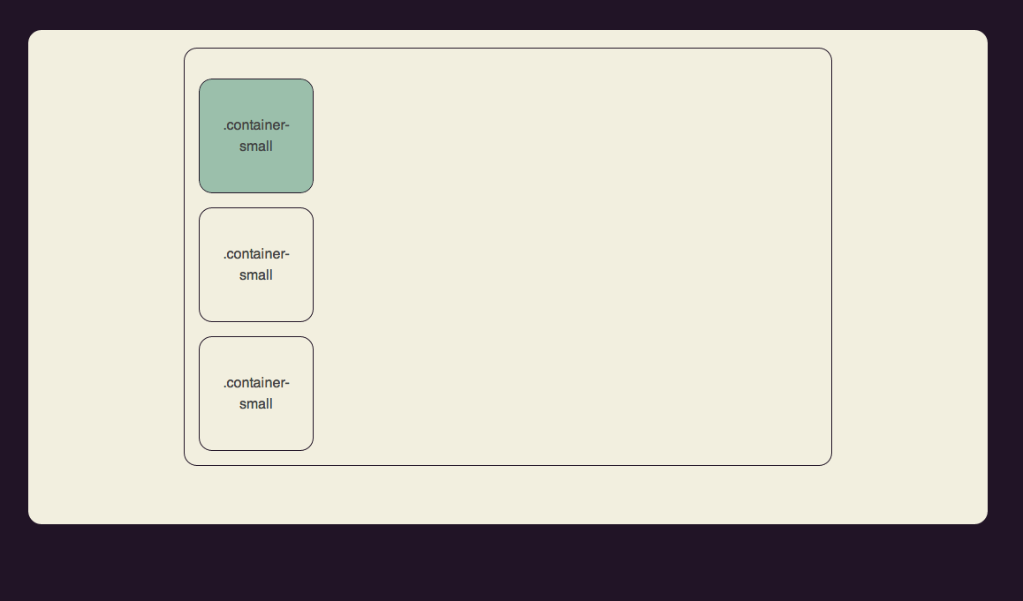
<div class="container container-outer">
&nbsp;
<div class="container container-small container-green">
<p>.container-small</p>
</div>
<div class="container container-small">
<p>.container-small</p>
</div>
<div class="container container-small">
<p>.container-small</p>
</div>
</div>
.container-outer {
width: 70%;
border: 1px solid #211426;
}
.container-small {
width: 5em;
min-height : 2em;
padding: 1.5em;
margin: 1em;
border: 1px solid #211426;
}

Slide 31
Float
elementer som skal flyte etter hverandre horisontalt kan få attributtet float:left/right.
.venstre{
float:left;
}

Slide 32
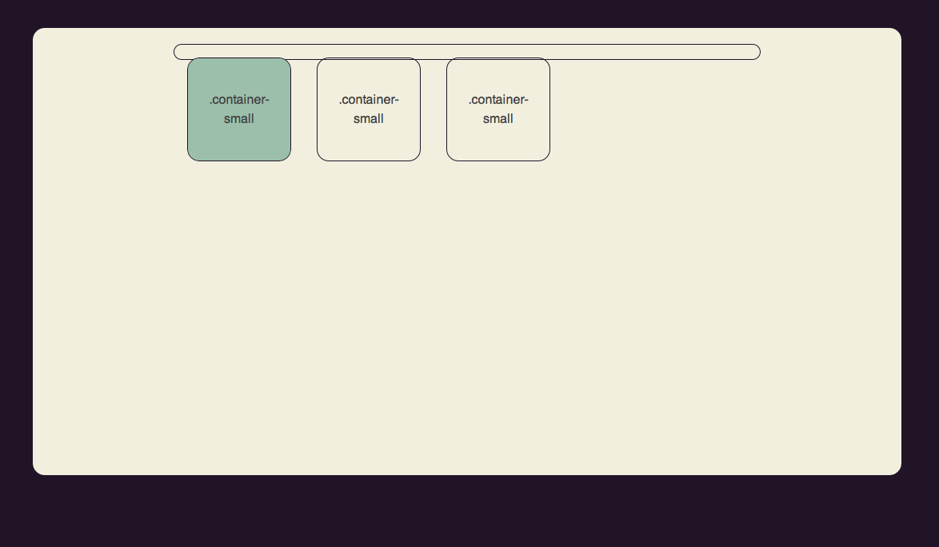
.container-outer {
width: 70%;
border: 1px solid #211426;
}
.container-small {
width: 5em;
min-height : 2em;
padding: 1.5em;
margin: 1em;
border: 1px solid #211426;
float: left;
}

Slide 33
Float – hvorfor blir det så rart?
Elementer med “float” havner utenfor sin parent-container.
Elementer som ikke skal omfattes av float, men for eksempel ligge under, må ha attributtet “clear:both”
eventuelt kan det legges en tom div-tag etter elementene som er floatet.

Slide 34
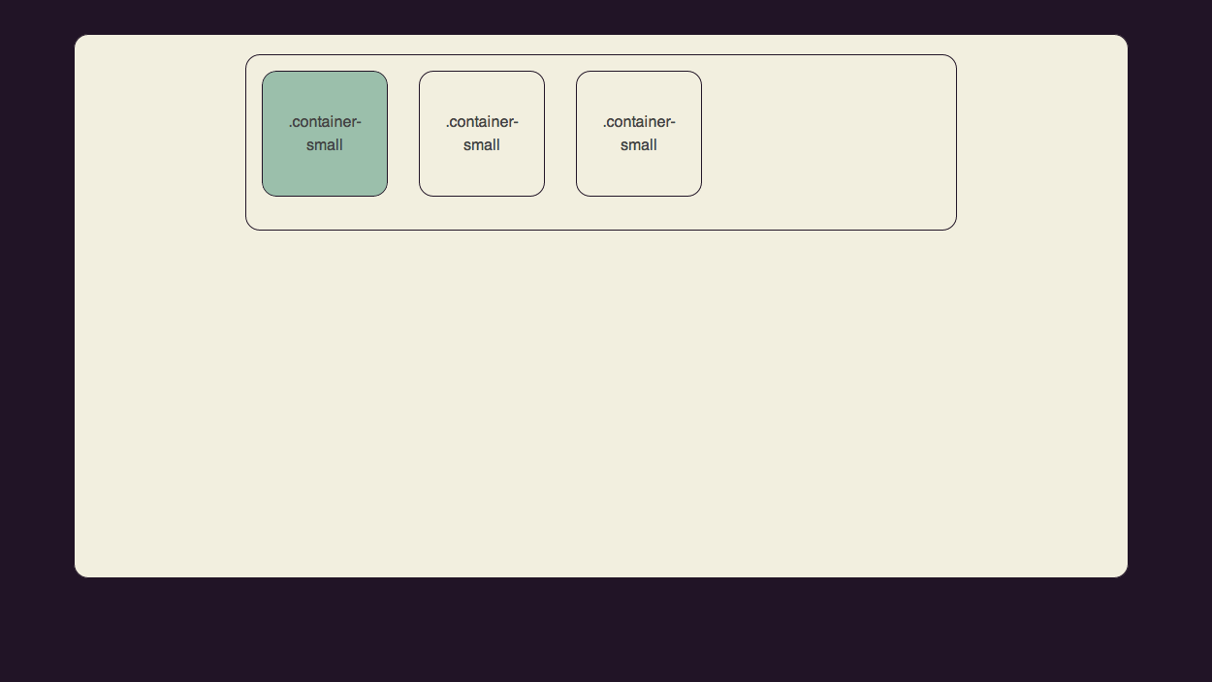
{clear:both }
<div class="container container-outer clearfix">
.clearfix:after {
content: ".";
display: block;
clear: both;
visibility: hidden;
line-height: 0;
height: 0;
}
<div class="container container-small">
<p>.container-small</p>
</div>
<div class="cleared" >
</div>
</div>
Semantisk mest korrekt måte.
Legger til bittelitt innhold etter containeren som har klassen .clearfix, som tar seg av clearing.
Fix
Fiks fix

Slide 35
Layout types
Fixed
Fluid
Elastic

Slide 36
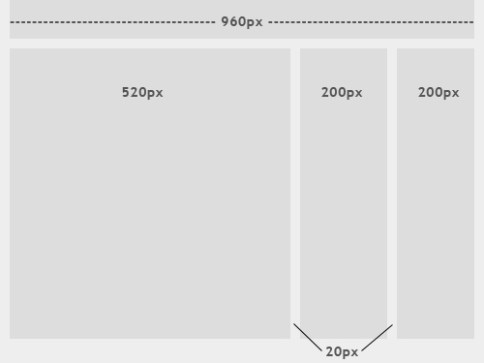
Fixed layout
PX

Slide 37
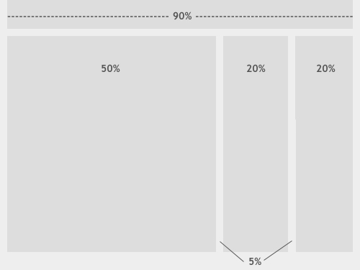
Fluid layout
%

Slide 38
Elastic layout
body {
...
font-size: 16px;
...
}
em
1em = 16px

Slide 39
http://simplebits.com/ fluid - %
http://ethanmarcotte.com/ elastic - em

Slide 40
Fra piksler til em
target ÷ context = result
Eksempel:
h1 str. 24px ÷ basis font 16px = 1,5em
http://pxtoem.com/

